Slide 1

THE FUTURE THE FUTURE OF AFFORDABLE HOUSING IN MOUNTAIN LAKES
Blair Schleicher Bravo 9/29/15
Notes:
Welcome- Introduction with a bit of background - LWV study on AH to HPMC to MHFH and moved 6 times first time homebuyer – does that count??
New Jersey is in a serious housing affordability crisis. As prosperity returns for many county residents, an unwanted effect is that upward pressure is exerted on local rents, making Morris County, and Northern New Jersey, among the least affordable areas to live in.
Rents are rising faster than wages, squeezing middle and lower income families. 45% of New Jersey households are spending more than the recommended 30 percent of their income on housing and more than half the state’s jobs paid less than $20 an hour.
Closer to home, in Morris County, housing for families earning $40,000 or less has virtually disappeared with only 8% of the housing units in the county considered affordable. Morris County is the tenth richest county in the United States, but nearly 28 percent of households struggle with housing costs. In order to afford a two-bedroom rental here, a minimum housing wage of $25/hour is needed. However, those whose occupations we depend on; social service workers, emergency dispatchers, child care workers, home health aides, school bus drivers, security guards, hairstylists, receptionists, cashiers, our own municipal workers –Give examples for our DPW and the county maintenance workers - have average wages below the minimum housing wage. Our economy will not thrive if so many of its workers cannot afford safe, decent housing in proximity to their jobs.
But what is often missing from the affordable housing discussion is a discussion of the many economic impacts occasioned by the lack of affordable housing. There is nothing fancy here, but the following observations are Economics­101. A serious consideration for any company considering locating their business in New Jersey, or the possibility of relocating out of New Jersey, is the cost of housing for their workers. Quite simply, workers need to be paid more to entice them to a market with higher housing costs. New Jersey has many of the highest housing costs in the nation. All things being equal, why would a company locate in New Jersey when the housing costs are so high and their workers are unable to afford decent housing? While there are other structural issues with the historically high office vacancy rates (e.g., companies require less office space), we cannot locate people in office seats if they do not live and cannot afford to live in New Jersey.
In short, New Jersey is out of critical balance between housing in general – affordable housing in particular – and certain commercial uses. This issue is not new, but has been brewing for years.
Boomerang children – children moving in with their parents because they cannot afford their own housing – and college grads moving out of state where housing and opportunity are more prevalent are just some of the many impacts created by the lack of affordable housing

Slide 2
The Need
4th most expensive state in nation = NJ
$61,000 - Household survival budget for a family of 4
Housing for families earning $40,000 or less has virtually disappeared
28% of households struggle with housing costs
8% of the housing units in the county are considered affordable
$25/hour- salary required to afford a 2 b/r rental $1500/month
Notes:
Before we can talk of the future of affordable housing in Mtn Lakes, we need to understand a few basics; the need and the past.
Here in Morris County, where the median income in $90,000 a year, sometimes it is difficult to imagine that people are struggling just to have a decent place to live.
Do the math. Suppose you are a family of four earning $50,000; that means you net around $3,000 in monthly take home pay. If you spend $2,000 on housing, you have a thousand dollars a month—for everything else—groceries, utilities, car insurance, clothes, school expenses, transportation, medical expenses, cable TV and internet—everything. The household survival budget for a family of 4 here –for just the basics like housing, transportation, food, health care— a bare bones budget-- is $61,000. That’s about $30/hr.
As in a lot of areas around the U.S., many of the people who keep our hospitals and universities and corporations running—many teachers and county government workers and those who work in hair and nail salons — cannot afford to live in the areas where they work. That doesn’t make sense, because communities are stronger when people live, shop, work and send their kids to school in a place they feel like they belong.
A few years back, the United Way of Northern NJ and our own Stephanie Hoopes studied low wage workers in Morris County (ALICE study). The findings underscored how the fate of our community is directly connected to ALICE’s (Asset Limited Income Constrained and Employed).
There are estimates the number of affordable housing units needed in Morris county to be three times the supply. Where do The ALICE households live? With over 17,000 of ALL rental households paying more than 50% of their income in rent, more people are looking for homes to rent at the same time rents are rising and only a fraction of those available at any point in time.

Slide 3
Impact of Affordable Housing
Positive impacts on residents’
Mental health
Personal safety
Economic independence.
Impact on Children
More parental support for academics
Could study more per week with a quiet place to study
Experienced less school disorder and violence
Notes:
A recent Princeton University study of a 100% affordable housing development in suburban New Jersey found that affordable housing in communities of higher opportunity had dramatic positive impacts on residents’:
mental health,
personal safety, and
Economic independence.
Children had more parental support for academics, could study more per week with a quiet
place to study, experienced less school disorder and violence, and attended better, more competitive schools,
with no overall effect on their grades. These housing opportunities had no adverse effect on crime in the
community, municipal property taxes, property values in the community, and specifically property values in
adjacent neighborhoods.

Slide 4
Definitions
Affordable Housing
Fair Share Housing
Low and Moderate Income Housing
Low Income
Moderate Income
Very Low Income
Vacant Land Adjustment
RDP
Notes:
Affordable Housing - whose cost (gross rents, including utilities, or mortgage payment, insurances, property taxes, and homeowner fees) is less than 30% of gross monthly income, adjusted for household size
Fair Share Housing- The portion of a region’s housing needs for which a municipality must create realistic housing opportunities for low and moderate income households
Low and Moderate Income Housing- Affordable housing occupied by and limited to income-qualified low and moderate income households
Low Income - A gross monthly income less than 50% of the regional median household income, adjusted for household size
Moderate Income -A gross monthly income between 50% to 80% of the regional median household income, adjusted for household size
Very Low Income - A gross monthly income less than 30% of the regional median household income, adjusted for hh size
Vacant Land Adjustment -communities with limited vacant land can seek to establish their fair share obligations based upon the available land capacity to accommodate new housing development.
RDP- realistic development potential

Slide 5
The Mount Laurel Doctrine 1971- 2015
Two NJ landmark planning & civil rights decisions:
1975 - Mount Laurel I
1983 - Mount Laurel II
1985 - Fair Housing Act
Notes:
The Mount Laurel Doctrine, which prohibits economic discrimination against the poor by the state and municipalities in the exercise of their land use powers, was the first case of its type in the nation and is widely regarded as one of the most significant civil rights cases in the United States since Brown v. Board of Education (1954). The Mount Laurel Doctrine today is a cornerstone of land use courses in all of our nation’s law schools.
1. The Mount Laurel Doctrine, based on the New Jersey State Constitution, requires all municipalities, and state agencies with land use authority, to plan, zone for, and take affirmative actions to create realistic opportunities for their “fair share” of their region’s present and prospective need for housing affordable to low and moderate income people.
The Mount Laurel Doctrine prohibits economic discrimination against the poor by the state and municipalities in their exercise of their land use powers.
Mount Laurel I. In 1975, the New Jersey Supreme Court found that municipalities are constitutionally obligated to provide a variety and choice of housing for citizens of all income levels, but the ruling had no teeth and little action was taken in response.
Between 1975 and 1983, most municipalities openly refused to implement Mount Laurel I.
1983 - Mount Laurel II: to address this widespread noncompliance, the New Jersey Supreme Court decided the Supreme Court reaffirmed and expanded the Mt. Laurel doctrine and stated that all municipalities share in the obligation.
The Supreme Court also created the “builder’s remedy,” whereby developers were entitled to rezoning and approval for inclusionary development for municipalities found to have engaged in exclusionary zoning.
2. in 1985 the Legislature and Governor enacted the Fair Housing Act, which established the Council on Affordable Housing (COAH) as the state agency responsible for calculating and allocating the need for affordable housing and reviewing and approving municipal plans to satisfy local fair share housing obligations.
Municipalities that choose to enter COAH’s process and obtain substantive certification of their fair share plans get an administrative shield from developer's lawsuits.
New Jersey municipalities enter the COAH process voluntarily by filing a housing element (required by the Municipal Land Use Law as part of each municipality's master plan) and a fair share plan establishing a realistic opportunity for the provision of a predetermined number of units affordable to low and moderate income households.
The Fair Housing Act provided for COAH to come up with municipal fair share numbers and acceptable compliance mechanisms every six years, giving rise to a series of “rounds” of compliance. For the Third Round, the six-year period was revised to be ten years.
More than 1/2 of New Jersey’s municipalities participated in the COAH process, while some non-participating municipalities were sued for alleged non-compliance with Mount Laurel. Other municipalities opted to have Mount Laurel compliance determined by trial courts.
Since 1985, as a result of Mount Laurel litigation, approximately 65,000 affordable housing units have been built in New Jersey’s suburbs, and many other states have adopted through legislative or court measures similar requirements.
The Mount Laurel Doctrine remains the nation’s strongest statewide affordable housing policy.

Slide 6
History of Affordable Housing in Mtn. Lakes
Pre-COAH
1945 Neffie’s Field: 90 homes of Veteran’s Housing
1986 : Spruce Edge and Pine Edge.- 9 lower cost townhomes
COAH Process
Round 1 - 1986: Housing Element is adopted in response to Fair Housing Act
Round 2 – 1996: New Master Plan is adopted with updated Housing Element/ Fair Share Plan-
COAH grants substantive cert. for RDP 29 units
Round 3 - 2004: Growth Share obligation = 11 unit obligation
- 2005 Fusee zoning expanded- 2 add’l units + 2 compliance bonus
- Affordable Housing Trust Fund established
- 2010 – COAH/Highlands Subcommittee Report to Borough Council
Notes:
1. Fun Fact! First affordable housing project: Neffie’s field – Housing for WWII Veterans; $9,900 for 2 bedrooms/bath, dining room and kitchen.
2. Noteworthy! In 1986, Mountain Lakes adopted a housing plan in response to the passage of the Fair Housing Act and MLUL requirements. The housing plan concluded that there was a limited amount of privately owned, developable land to accommodate the 1986 COAH estimate of 91 units of new housing.
3. The Developer of Spruce and Pine Edge built 3 smaller units in Pine Edge and 6 smaller units in Spruce Edge in deal with Borough and then sold them for less than market value (i.e., $200k vs $265k in Pine Edge and $300k vs $400k in Spruce Edge) with a deed restriction that they could not be resold for five years. They were sold to seniors and people with disabilities in late 80s and early 90s. Can’t be considered affordable housing units, but was done in recognition of the need.
4. 1996 – Borough adopts new Master Plan with updated Housing Element and Fair Share Plan. The total adjusted housing obligation was 29 units.
The Borough proposed to satisfy the adjusted housing obligation (29 units) using several approaches as follows:
A Regional Contribution Agreement for 12 units with another willing community in the region. (City of Orange)
A local rehabilitation program to provide loans to 11 eligible households to upgrade their homes.
Zoning revisions to provide 6 affordable housing units in the Borough.
5. COAH certified the Borough’s prior round Housing Element & Fair Share Plan on March 5, 1997.
As part of certification COAH granted the Borough a vacant land adjustment in recognition of the Borough’s insufficient land capacity to satisfy the COAH-determined 80-unit new construction portion of the obligation.
Instead, the Borough’s realistic development potential was determined to be 18 units, which was satisfied with inclusionary zoning and a regional contribution agreement (RCA).
** The RCA provides the municipalities the option to “send” part of their obligation (up to 50%) to another community by paying that community to build homes there, usually $20,000 per unit. Also, see 3rd round rule amendments.
The unmet need of 62 units was addressed by establishing a Borough-wide overlay zone requiring affordable housing as part of any new residential development comprised of five or more units.
Mountain Lakes’ cumulative first and second round obligation (now referred to as the prior round obligation) was 91 units, comprised of 80 units of new construction and 11 units of rehabilitation.
2004: COAH adopted “third round” rules establishing a new methodology known as “growth share” by which municipalities would make their own projections of growth for the period 2004-2014 and provide affordable housing in proportion to market rate development: one affordable unit for every eight market rate residential units and one affordable unit for every 25 jobs attributed to nonresidential development.
2010 – interesting year: the State senate introduces S-1 to abolish COAH and also proposes that municipality apply to the state planning commission for a determination as to whether the municipality met the threshold for inclusionary in compliance with fair housing requirements based on whether the community's housing stock satisfied one of 2 thresholds:
Price restricted affordable housing units equals 7.5% of housing stock or
The # of multifamily, single family attached equals 33% of the housing stock.
Borough Council had several decision: decide whether it will opt in to the Highlands process and accept Highlands jurisdiction – adjusted growth share of 11 units, be protected from a builder’s remedy lawsuit but also be required to petition the highlands council for Plan Conformance (would have to amend our master plan and adopt model highlands ordinances which were more restrictive than we liked (300’ buffer around lakes- for example).
or the Borough needed to address a vacant land adjustment obligation of 45+ units in lieu of full compliance with the COAH –determined obligation of 89 units.
A 3rd alternative was to ‘go it alone.’
The COAH-Highlands Subcommittee issued its report on April 26, 2010.
The committee DID NOT make a formal recommendation at the time. The issues were complex and would require significant policy decisions for the borough council. The validity of the political scene with the Governor and COAH with several court challenges to the 3rd round rules and pending legislation that could drastically alter the way NJ approaches affordable housing and eliminate COAH altogether and rethink the Highlands Council, and the fact that we could NOT come up with a plan that would demonstrate Mt Lakes could provide for 40+ units, she advised us to NOT file a 3rd round plan of course recognizing that we would be left somewhat exposed after the expiration of our second round substantive certification. While there was no formal decision made from the council (COAH AND THE HIGHLANDS processes are voluntary!), the council accepted the committee’s conclusions and began to evaluate and outline what a local Mt Lakes affordable housing plan might look like to continue working to provide a range of housing opportunities.

Slide 7
THE SUPREME COURT’S March 2015 Decision
MILESTONE DECISION! -The courts –and not (COAH) would create a process for municipalities for judicial review and constitutional compliance
Reaffirmed the Mount Laurel Doctrine
Declared COAH to be “moribund,”
Established an orderly compliance review process
First & Second Round Rules should be used to establish present and prospective housing need.
Notes:
On March 10, 2015, in a milestone decision, the New Jersey Supreme Court decided that the courts –and not the Council on Affordable Housing (COAH) – and declared COAH to be “Moribund” - AND RETURNED ENFORCEMENT OF THE FAIR HOUSING ACT AND THE MOUNT LAUREL
The decisions states that "the courts are the only available forum for addressing these matters.”
Court recognized 2 types of municipalities:
those that filed their 3rd round fair share housing plan with COAH that COAH approved (68 munis) and
Those participating municipalities that had filed a 3rd round plan after 2008 that was still pending COAH review (314 munis)
The court did not discuss those municipalities such as Mtn. Lakes without an approved or pending plan.
“3rd round fair share housing obligations were to be determined by the 1st & 2nd round rules to determine present and prospective need. The parties should demonstrate to the trial court computations of housing need and municipal obligations based on those prior round methodologies.”

Slide 8
What Happens Now?
Develop housing plan element for the Master Plan that:
a. Identifies Mtn. Lakes’ affordable
housing need and
b. Identify opportunities – where to
build, what to build and to
consider working with non profits
Compliance prevents Builder’s Remedy Lawsuit
Notes:
Borough should be in the ‘driver’s seat’
1. Develop housing plan element for the Master Plan that :
a. Identifies Mtn. Lakes’ affordable housing need and
b. Identify opportunities – where to build, what to build and to consider working with non profits
Identify realistic opportunities for affordable housing in a manner compatible with the established character, residential densities, and development capacity of the Borough.
Develop a Housing Plan Element to address whether the community has the capacity to accommodate its present and prospective needs including fair sharing of low-mod housing
As defined by COAH, a “fair share plan” is the document in which the municipality details specifically the affirmative actions it will take to create a “realistic opportunity” to satisfy its fair share housing obligations, including proposed or adopted ordinances and resolutions.
A housing element and fair share plan, is prepared and adopted by the planning board and endorsed by the governing body.
The essential elements of the municipal housing plan, which must be designed to “achieve the goal of access to affordable housing to meet present and prospective housing needs” and pay “particular attention to low and moderate income housing”.
For all options, three ingredients are essential: (a) a suitable site or property with permissive zoning or land
use approvals, (b) a developer with capacity, and (c) adequate financial resources.
WHAT IS A BUILDER'S REMEDY LAWSUIT?
A “Builder’s Remedy Lawsuit” is simply legal action taken by a property developer in an attempt to force a municipality to permit construction of a large, multi-family housing structure or complex. By filing an affordable housing plan with the Council on Affordable Housing (COAH), the State of NJ office responsible for determining affordable housing requirements, municipalities can protect themselves against “Builder's Remedy Lawsuits.”
Hundreds of municipalities have filed with trial courts and claimed they are entitled to protection from builder’s remedy lawsuits. Many of those municipalities though have a poor track record and are resisting the Supreme Court’s five month deadline. The March 2015 decision makes clear that municipalities must earn protection from builder’s remedy lawsuits and that such protection is not automatic. Municipalities that have a poor track record and have wasted the past four months should be very concerned. The decision also makes clear that the five month clock is running.
Judge Wolfson set out three "protocols" that parties should follow.
First, interested parties—such as developers and affordable housing advocates—will be allowed to intervene, but only for the limited purpose of assisting the court in determining whether a given municipality's plan is constitutional.
Second, no builder's remedy can be filed until it has been determined that a municipality's plan has been found to be deficient and that the municipality has failed to timely craft a compliant plan.
Third, builders' remedies can be filed after a municipality's plan has been found to be noncompliant. The successful builder's remedy will be the one that is based on principles of sound planning and not necessarily the one that was filed first.

Slide 9
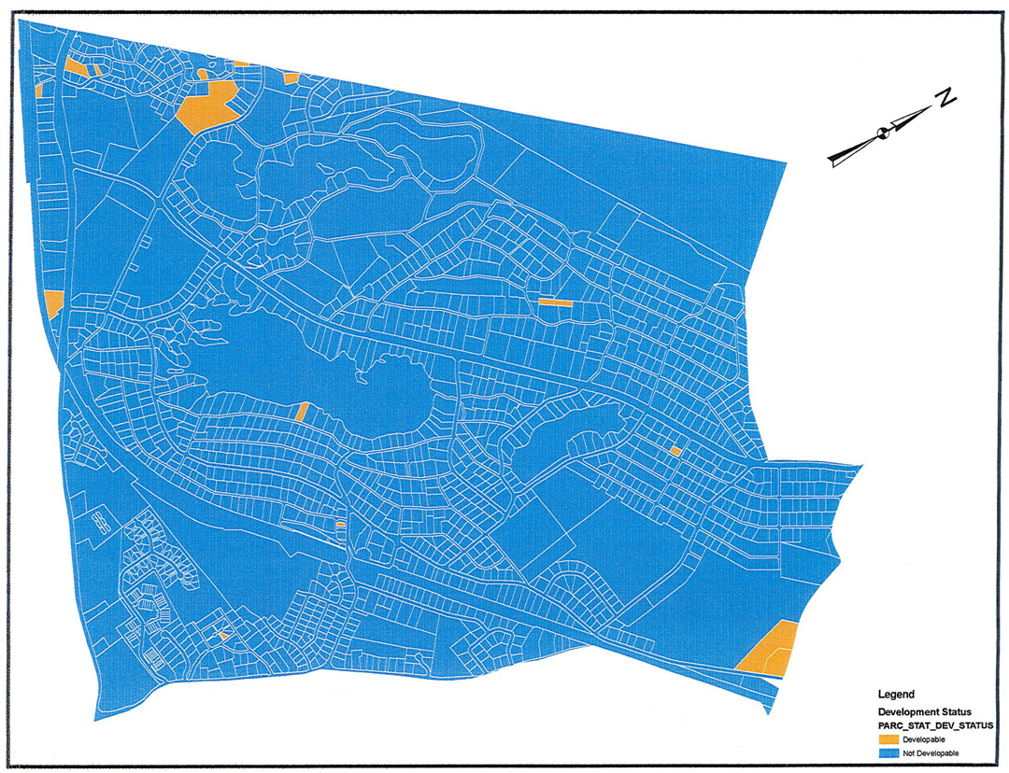
Mtn. Lakes Development Status*
*a/o 2010

Slide 10
Options for Municipalities
Present Need – Rehabilitation
100% Affordable (family or senior) *
Inclusionary Development and Zoning
Supportive and Special Needs Housing
Assisted Living Residences:
Notes:
Options to Satisfy its Affordable Housing Obligations
In addition to legal protection, participation in COAH's process allows the community to maintain local control over the planning process for affordable housing instead of having a court-imposed housing plan.
Moreover, maintaining local control gives Mountain Lakes the ability to determine appropriate locations for and design/amenities in housing developments consistent with the character of the community.
Not an exhaustive list-
* Present Need – Rehabilitation: The present need component of the fair share obligation signifies that low and moderate income households are living in substandard and overcrowded housing in the Municipality and in need of repair.
* Municipally sponsored and 100% affordable developments include, but are not limited to: [most popular- accounts for ½ the built affordable units]
1. Developments in which all units are available to low- and moderate-income households;
2. Units created through a municipal partnership with a non-profit or other affordable housing provider; and
3. Developments for which the municipality serves as the primary sponsor.
Inclusionary Developments: A minimum 20% set-aside is required, to the extent economically feasible, in new inclusionary developments within the jurisdiction of New Jersey’s regional planning agencies: Meadowlands Commission, Pinelands Commission, Fort Monmouth Economic Revitalization Planning Authority, and Highlands Council.
Throughout the state, municipalities must provide, through their zoning powers, incentives to ensure the economic feasibility of inclusionary development, including increased densities and reduced costs, and may in some cases include reduced set-asides.
COAH rules also require presumptive minimum gross densities in built-up communities of six (6) units per acre with a 20% set-aside. For rental housing, COAH rules require a presumptive minimum gross density of ten (10) units per acre with a 15% set-aside.
****Accessible and adaptable affordable units--The first floor of all new townhouse dwelling units and of all other new multistory dwelling units that are attached to at least one other dwelling unit are subject to the standards of the Barrier Free Sub code.

Slide 11
Options for Municipalities
Accessory Apartments/ECHO units
Redevelopment
Market to Affordable Program
Expiring Controls
Affordable Housing Trust Funds**
Notes:
Accessory units - are units, which have been added onto, or created within, a single-family house. The eating, bathing, and sleeping areas are separate from those in the main dwelling.
Municipalities can encourage and make possible the creation of affordable accessory apartments
by first amending zoning to permit a second dwelling unit on an otherwise single family lot and by providing
financial assistance to homeowners to undertake the necessary construction or renovations. This is not,
however, a very common, productive compliance mechanism, as COAH has counted only 111 affordable
accessory apartments created.
ECHO units are modular, self-contained units erected on sites containing an existing dwelling, which may only address a municipality’s rehabilitation share.--no more than 10 units can be in the plan.
Redevelopment- not an affordable housing type but a popular way for rebuilding communities.-- however think about what we have that could be redeveloped, such as office parks, foreclosures, etc.
A market to affordable program shall include units purchased or subsidized through a written agreement with the property owner and sold or rented to low- and moderate-income households. Municipalities subsidize the difference.
Expiring Controls : Munis may extend the term of controls through agreement with the housing owner-doesn’t increase the supply but ensures that affordable units continue to be available to income eligible households.
**AHTF: a flexible funding source that has helped many municipalities address their fair share housing
obligations. development fees from residential and non-residential development, which did not include affordable housing, for the purpose of funding affordable housing activities.
More than $890 million has been collected in AHTF and at least $337 million has been spent on affordable housing activities.
An April 2015 decision, the Appellate Division ruled that neither COAH nor any part of the executive
branch could take the funds. Instead, trial courts would be responsible for reviewing and approving, on a case by-case basis, municipal proposals to use local housing trust funds to help nonprofits and developers build
affordable housing and expand housing opportunities.

Slide 12
What can citizens do?
Understand what affordable housing is and why necessary
Attend and participate at local public meetings on housing planning
To ensure an open process for developing an effective municipal housing elements and fair share plans
Understand what ML fair share housing obligation is and how and when it will comply
Notes:
Ensure that effective municipal housing elements and fair share plans are prepared, discussed openly, adopted, filed with trial courts, reviewed, and approved, and vigorously implemented

Slide 13
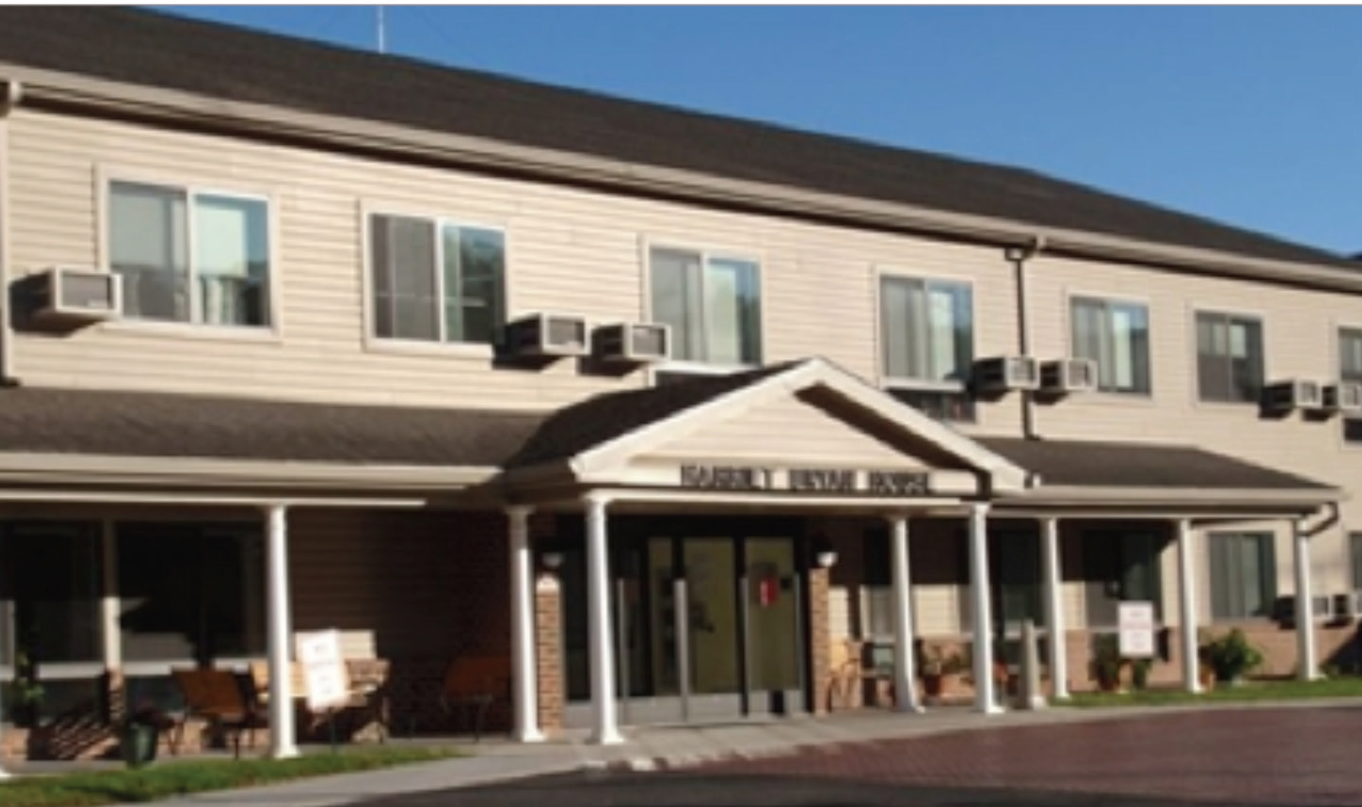
Harriet Bryan House - Princeton
Notes:
VERY LOW INCOME ELDERLY
Project Name: Harriet Bryan House
Project Address: 310 Elm Road in Princeton
Developer: Princeton Community Housing
Year Completed: 2007
Total Units: 67
Type & Tenure: Rental
Affordable Housing Set Aside: 67 one-bedroom apartments for very low income elderly residents
are units, which have been added onto, or created within, a single-family house. The eating, bathing, and sleeping areas are separate from those in the main dwelling.

Slide 14
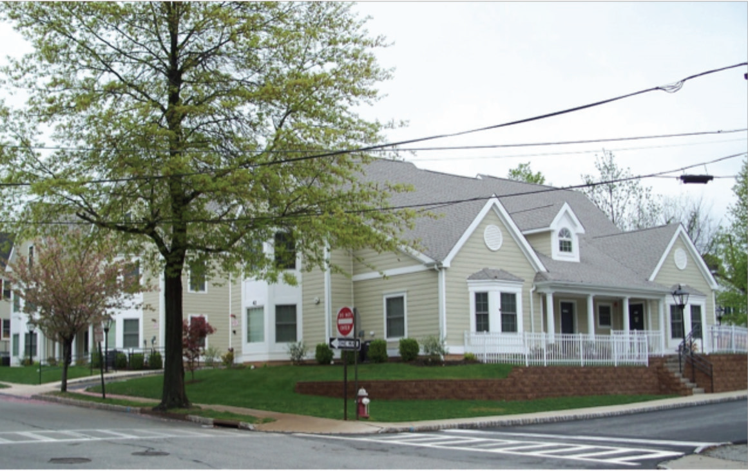
The Abbett Avenue Apartments- Morristown
Notes:
Project Name: The Abbett Avenue Apartments
Project Address: 38-42 Abbett Avenue, Morristown
Developer: Homeless Solutions Inc.
Year Completed: 2008 Total Units: 12
Type & Tenure: Rental apartments
Affordable Housing Set Aside: 12 unit for families
Funding Sources: Low Income Housing Tax Credit.
County, HOME funds, privately raised

Slide 15
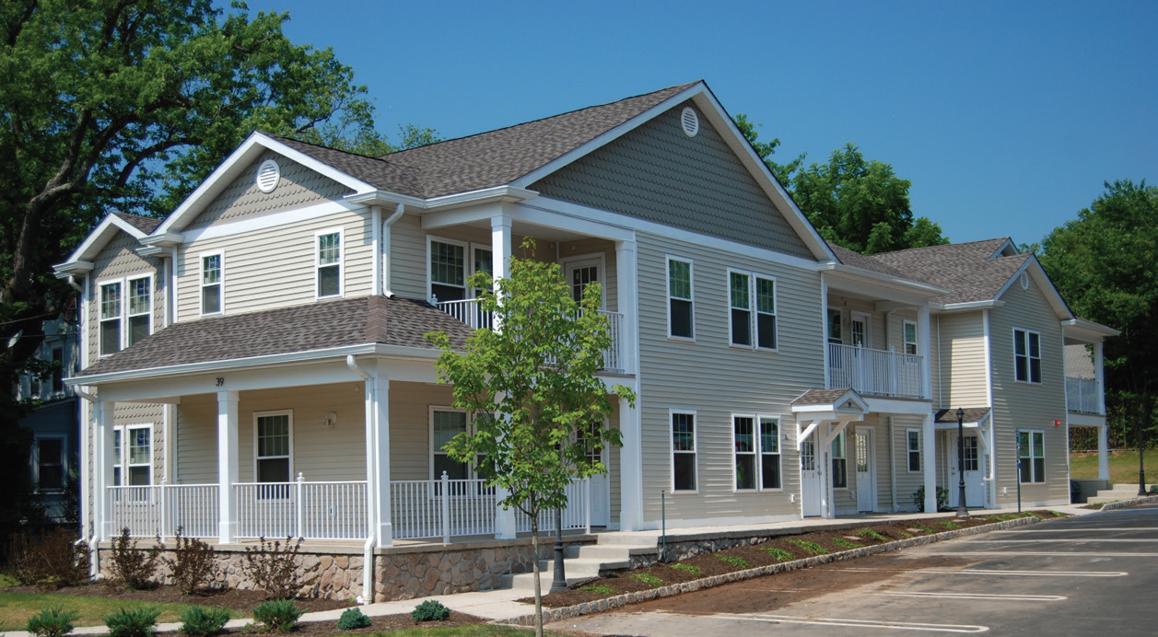
Morris Habitat for Humanity 6-Plex- Summit
Notes:
Project Name: Summit Interfaith & Community Build
Project Address: 39 Morris Ave. Summit
Developer: Collaborative effort between the City of
Summit, the Summit Affordable Housing Corporation and
Morris Habitat for Humanity Habitat of Morris County
Year Completed: Winter 2011 Total Units: 6
Type & Tenure: Homeowner Condominiums
Affordable Housing Set Aside: 6 Families

Slide 16
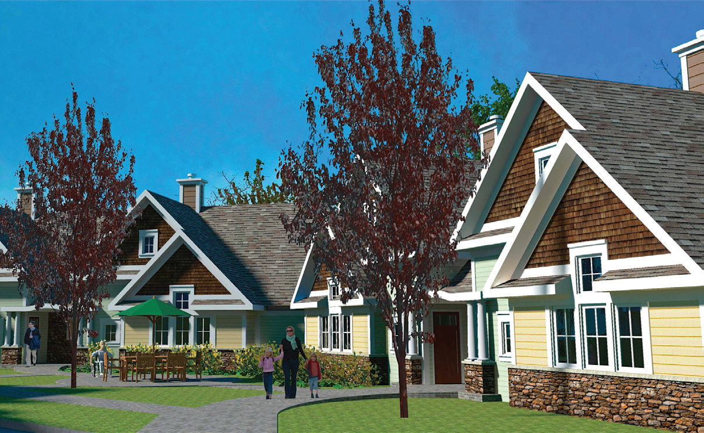
A Very Special Homes Development - Tenafly
Notes:
Project Name: A Very Special Homes Development in Tenafly
Project Address: 311 Tenafly Road, Tenafly
Developer: Bergen County United Way /Madeline
Year Completed: 2016
Total Units: 6
Type & Tenure: Rental
Affordable Housing Set-Aside: 10 individuals with developmental disabilities.

Slide 17
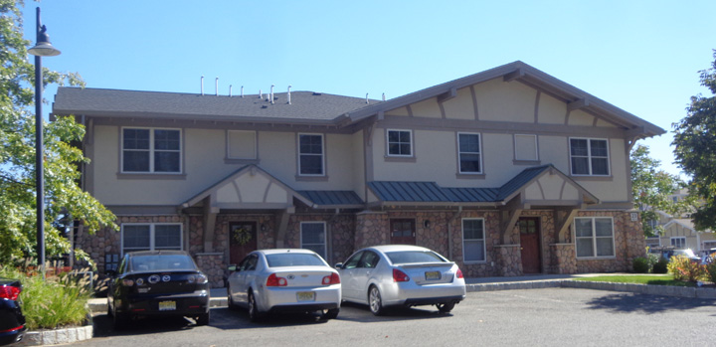
Legacy - Mountain Lakes
Notes:
8 units affordable for low- and moderate-income households homeownership
The affordable housing available ranges in price from $73,874 to $158,843 and includes one, two and three-bedroom units.
Income ranges were $30,630 for one person to $81,213 for a six-person household.
$56,009 for a two-person household; $63,010 for a three-person household; $70,011 for a four-person household; $75,612 for a five-person household; and

Slide 18
Discussion
Mountain Lakes has an affordable housing obligation.
1. Where do you think we should build it?
2. Would you or any member of your family live there?
Notes:
New Jersey’s Mount Laurel doctrine makes the state a national leader in breaking down the barriers of exclusionary zoning and producing affordable housing.
The Court provides important opportunities to meet that need and realize the vision of the Mount Laurel doctrine and the Fair Housing Act.
Questions?
Thank you.

Slide 19
Thank you!
For more information, please call:
Blair Schleicher Bravo
Morris Habitat for Humanity
973.891.1934 x 102

